Slide 1
Example web network
Each page in this PDF document represents a webpage with links

Slide 2
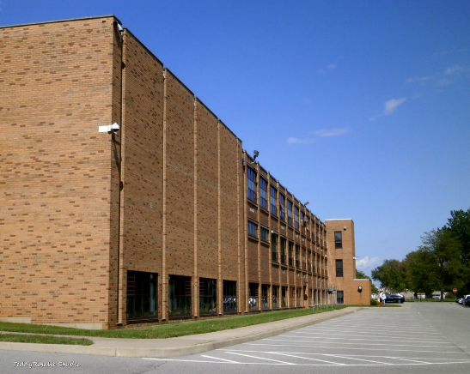
ABC School Homepage
Welcome to ABC School! From this home page you can view:
School Calendar
Student Clubs
About Our School

Slide 3
ABC School - Calendar
Here is the school calendar
Back to home page

Slide 4
ABC School - Student Clubs
Our school has many clubs:
New student club
Math club
Gamers group
Geocaching club
Back to home page

Slide 5
ABC School - About Us
Our school is small but wonderful. We serve the community of Springfield. Students from grades 10 - 12 attend our school.
Contact us
Administrative staff
Teachers
Back to home page

Slide 6
ABC School - Contact
Mailing Address: 123 Main St, Springfield, QC, D4P 1X1
Email: contact@abcschool.com
Below are links to lists of staff and teachers:
Administrative Staff
Teachers
Back to home page

Slide 7
ABC School - Administrative Staff
Principal: Albus Dumbledore
Vice Principal: Minerva McGonagall
Keeper of the Dragons: Rubeus Hagrid
Back to contact
Back to home page

Slide 8
ABC School - Teachers
English: Margaret Atwood
French: Albert Camus
Math: Florence Nightingale
Biology: Charles Darwin
Physics: Marie Curie
Art: Frida Kahlo
Back to contact
Back to home page

Slide 9
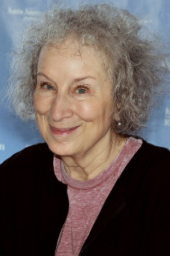
ABC School - Margaret Atwood
English: Margaret Atwood
Back to Teachers
Back to home page

Slide 10
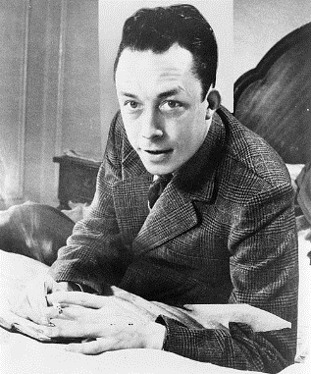
ABC School - Albert Camus
French: Albert Camus
Back to Teachers
Back to home page

Slide 11
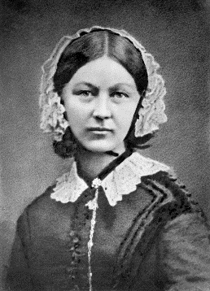
ABC School - Florence Nightingale
Math: Florence Nightingale
Back to Teachers
Back to home page

Slide 12
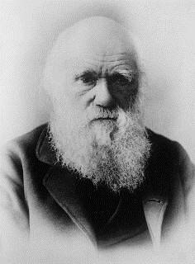
ABC School - Charles Darwin
Biology: Charles Darwin
Back to Teachers
Back to home page

Slide 13
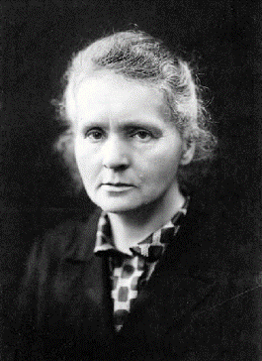
ABC School - Marie Curie
Physics: Marie Curie
Back to Teachers
Back to home page

Slide 14
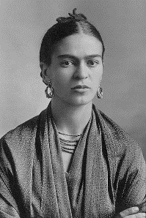
ABC School - Frida Kahlo
Art: Frida Kahlo
Back to Teachers
Back to home page

Slide 15
Acknowledgments
"High School" by cordeliasmom2012 is licensed under CC BY-NC-ND 2.0
“Margaret Atwood” by Larry D. Moore, CC BY-SA 4.0, Wikimedia Commons.
“Albert Camus” This image is available from the United States Library of Congress's Prints and Photographs division
under the digital ID cph.3c08028
“Florence Nightingale” https://commons.wikimedia.org/wiki/File:Florence_Nightingale_(H_Hering_NPG_x82368).jpg in the public domain
“Charles Darwin” This image is available from the United States Library of Congress's Prints and Photographs division
under the digital ID ggbain.03485.
“Marie Curie”, https://commons.wikimedia.org/wiki/File:Marie_Curie_c1920.png, in the public domain
“Frida Kahlo”, https://commons.wikimedia.org/wiki/File:Frida_Kahlo,_by_Guillermo_Kahlo.jpg, in the public domain

